Slide 1




NEXT GEN EMPLOYABILITY PROGRAM
Creating a future-ready workforce
Team Members
College Name
Student Name : MANIKANDAN.S
Student ID : au110621104015
INDIRA INSTITUTE OF ENGINEERING AND TECHNOLOGY

Slide 2

CAPSTONE PROJECT SHOWCASE
Project Title
MUSIC WEB APPLICATION USING DJANGO FRAMEWORK
Abstract | Problem Statement | Project Overview | Proposed Solution | Technology Used | Modelling & Results | Conclusion

Slide 3
Abstract
Now a days peoples more like to liste songs while working, walking or in their free time for relaxing or for taking break from this world. In old days people have to download first songs and they can listen on the device but now a days there is lots of application where you can listen a songs without downloading and also they provide search engine so people can easily find out songs but for this all services they are taking some charges. But in this application people can registration without paying any cost and there is different types of features are available in this application like people can create their own album, own playlist, etc. also in this app people can download songs so while offline they can listen songs without any interrupt. The system is build fully in Django Framework in back-end and HTML, CSS in front-end. It has similar features as popular music streaming service “Spotify” where music creators share their music through this app and other users can listen to their music or whole album.
This app also provides features of downloading the music so the users can stream music even when they are offline. It is free to register for any user and they all can share their music to the world.
Keyphrases: All Music, Best Music, Free Music Downloads, Hip-hop music, instrumental music, Latest Music, Mp3 Music, Music Chart, Music lyrics, online radio, rap music
Source :

Slide 4
Problem Statement
The goal of this project is to develop a music web application using the Django framework. The application aims to provide users with a platform where they can discover, listen to, and share music seamlessly. The key features of the application include user authentication, music streaming, playlist creation, search functionality, and social sharing capabilities.
Problem Description:
1) User Authentication
2) Music Streaming
3) Playlist Creation
4) Search Functionality
5) Social Sharing
6) User Profiles
7) Responsive Design
Source :

Slide 5
Project Overview
1. Introduction:
The music web application aims to provide users with a platform to discover, listen to, and share music seamlessly. Developed using the Django framework, the application will incorporate key features such as user authentication, music streaming, playlist creation, search functionality, and social sharing capabilities.
2. Features:
1)User Authentication
2)Music Streaming
3)Playlist Creation
4)Search Functionality
5)Social Sharing
6)User Profiles
3. Technology Stack:
Backend Framework: Django
Frontend: HTML, CSS, JavaScript
Database: SQLite (for development), PostgreSQL (for production)
Deployment: Heroku, AWS, or similar cloud platform
Version Control: Git (GitHub or GitLab)
Source :

Slide 6
Proposed Solution
1.Overview:
The proposed solution is to develop a music web application using the Django framework, providing users with a seamless platform for discovering, listening to, and sharing music. The solution will incorporate essential features such as user authentication, music streaming, playlist management, search functionality, and social sharing capabilities.
2.Architecture:
a. Backend: Django framework will handle the backend logic, user authentication, data management, and API endpoints.
b. Frontend: HTML, CSS, and JavaScript will be used to create a responsive and interactive user interface. Frontend frameworks like Bootstrap may also be utilized.
c. Database: SQLite will be used for development, and PostgreSQL will be employed for production to manage data such as user profiles, music metadata, playlists, and social interactions.
d. Deployment: The application will be deployed on cloud platforms like Heroku or AWS, ensuring scalability and reliability.
3.Key Features:
a. User Authentication: Users can register, log in, and log out securely. Passwords will be hashed for storage security.
b. Music Streaming: Integrated music player allows users to stream audio tracks with playback controls such as play, pause, skip, and volume adjustment.
c. Playlist Management: Users can create, edit, and delete playlists. They can add tracks to playlists, reorder them, and manage their playlists effectively.
d. Search Functionality: Robust search feature enables users to search for artists, albums, or tracks. Search results will be displayed in an organized manner, enhancing user experience.
.
Source :

Slide 7
e. Social Sharing: Users can share their favorite music tracks, albums, or playlists on popular social media platforms like Facebook, Twitter, and Instagram, promoting user engagement and virality.
f. User Profiles: Each user will have a profile page displaying their playlists, liked tracks, followers (if applicable), and other relevant information. Users can follow other users, view their activity, and discover new music based on their preferences.
g. Responsive Design: The application will be responsive and accessible across various devices, including desktops, tablets, and smartphones, ensuring a consistent user experience.
4. Implementation Plan:
a. Database Design: Design and implement the database schema to store user data, music metadata, playlists, social interactions, etc.
b. User Authentication: Implement user registration, login, logout functionalities with password hashing for security.
c. Music Streaming: Integrate a music player with streaming capabilities, incorporating playback controls and audio formats support.
d. Playlist Management: Develop features for creating, editing, and deleting playlists, along with adding/removing tracks and reordering playlists.
e. Search Functionality: Implement a robust search feature using Django's ORM or external search engines to retrieve relevant search results.
f. Social Sharing: Integrate social media sharing APIs to enable users to share music content seamlessly.
Source :

Slide 8
5. Deployment and Maintenance:
a. Deploy the application on a chosen cloud platform (Heroku, AWS, etc.) with proper configuration for scalability and performance optimization.
b. Regularly update and maintain the application, addressing any bugs, security vulnerabilities, or performance issues that may arise.
c. Monitor user feedback and analytics to continuously improve and enhance the application's features and user experience.
By following this proposed solution, we aim to deliver a high-quality music web application that meets user expectations, provides a seamless music streaming experience, and fosters user engagement and interaction within the platform.
Source :

Slide 9


Technology Used
Front-end
Back-end
Source :

Slide 10
Modelling & Results
Modeling:
Database Design: Utilize Django's built-in ORM to design models for representing music tracks, albums, artists, genres, playlists, and user profiles. Define relationships between models such as Many-to-One, Many-to-Many, and One-to-One to establish a cohesive data structure.
User Authentication: Implement Django's user authentication system to manage user registration, login, logout, and profile management functionalities.
Content Management: Develop Django admin interfaces for managing music content, allowing administrators to add, edit, and delete tracks, albums, artists, and genres easily.
Results:
Audio Playback: Users can stream music tracks directly within the application, with support for basic playback controls such as play, pause, skip, and volume adjustment.
Music Content Management: Administrators can manage music content through the Django admin interface, adding new tracks, albums, and artists easily.
Source :

Slide 11
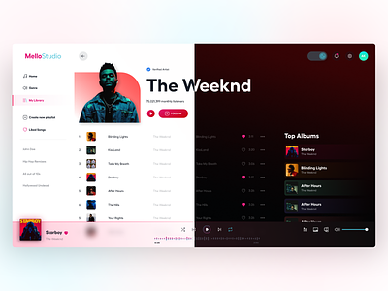
Homepage
Creating a homepage for a music web app involves showcasing the app's features, highlighting its benefits, and providing easy navigation for users. Here's a structured approach you might consider.
1)Header Section
2)Hero Section
3)Features Section
4)How It Work
5)Music Discovery
6)Subscription/Pricing
7)About Us
8)Footer Section

Slide 12
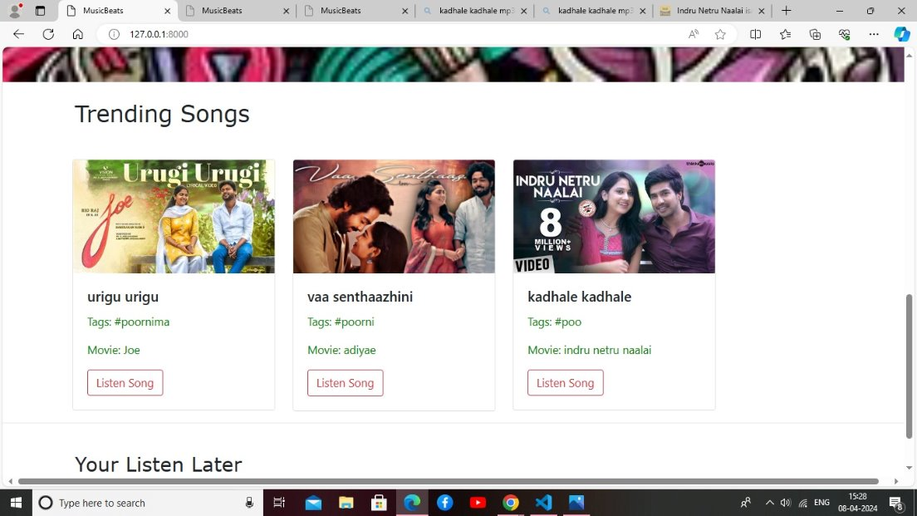
About-Us-Page

Slide 13
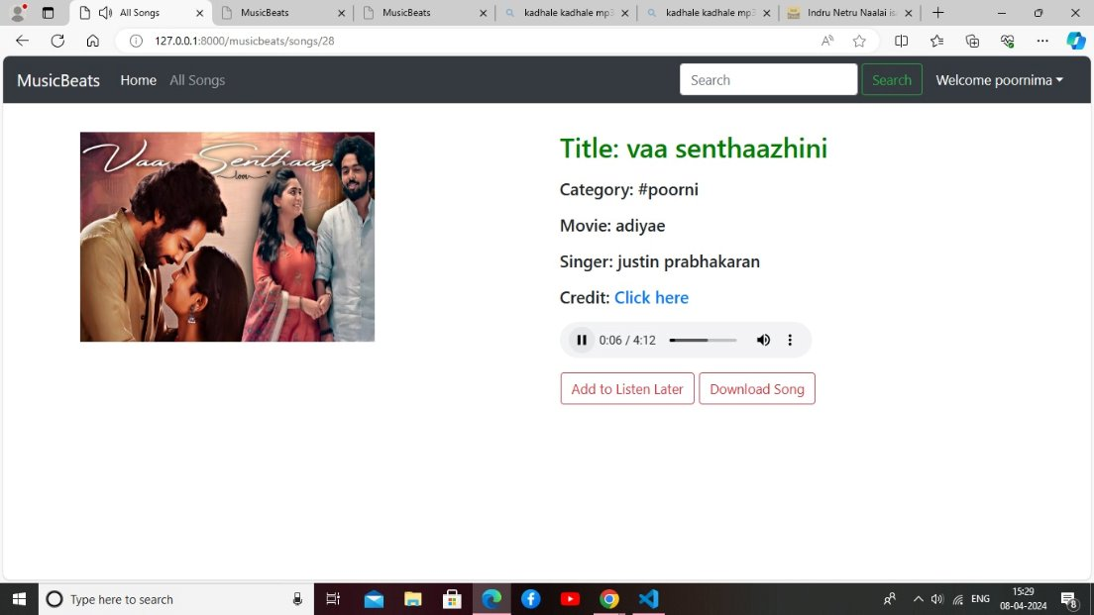
Service-Page

Slide 14
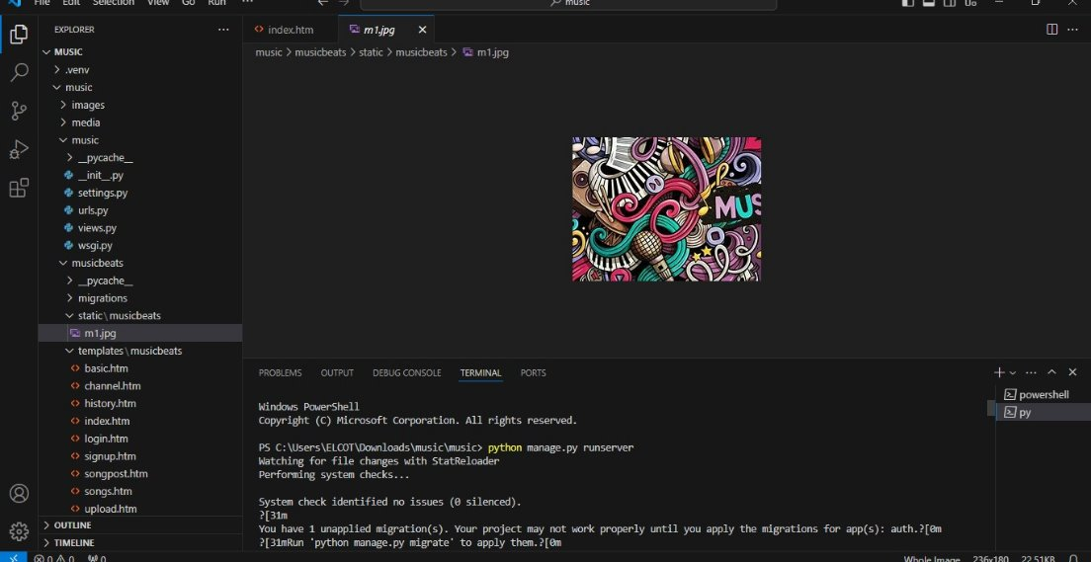
Departments-Page

Slide 15
Blog-Page

Slide 16
Future Enhancements
Offline Mode and Downloading: Implement offline mode functionality, allowing users to download music for offline listening.
Social Integration: Enhance social features by integrating with popular social media platforms, allowing users to share their favorite tracks, playlists, and music discoveries with friends.
Personalized Recommendations: Implement advanced recommendation algorithms based on user listening history, preferences, and behaviors.
Music Discovery Features: Expand music discovery features by incorporating trending charts, new releases, and curated playlists from popular genres and artists.
Collaborative Playlists: Enable collaborative playlist creation, allowing multiple users to contribute and collaborate on playlists together.
Live Streaming and Events: Introduce live streaming capabilities for music performances, concerts, and events within the application.
Audio Content: Expand the platform to include podcasts, audiobooks, and other audio content beyond music.
:

Slide 17
Conclusion
In conclusion, developing a music web application using the Django framework offers several advantages and opportunities for creating a robust and user-friendly platform. Django's powerful features such as its built-in authentication system, ORM for database management, and templating engine make it well-suited for building complex web applications like music streaming services or online music stores.
Source :

Slide 18
Thank You!
Notes:
Thank You !!

